Slide 1




Knoelle Grassi & Samantha Bentley
KGSB Clothing
We are a distinguished retailer of Western apparel, with an extensive network of stores spanning 16 states, ranging from Florida to Washington.
Our most popular products include Silk Blouse, Ankle Boots, Knit Sweater, and Pocket Pants.
Christian Navarro
“Wow, its amazing product!”

Slide 2




PROBLEMS
PROBLEMS
INVENTORY CHALLENGES:
Inaccurate stock levels
Inefficient replenishment processes
Difficulty managing returns
CUSTOMER DATA ISSUES:
Disorganized customer profiles
Scattered purchase history
Lack of key details
DATA STRUGGLES:
Data inconsistencies
Duplication of information
Slow and cumbersome retrieval
Notes:
Problem

Slide 3





proposed solution
To tackle the inventory challenges, customer data issues, and data struggles encountered by the business, we recommend adopting a robust database solution based on the Database Life Cycle (DBLC) methodology.
This proposed solution will prioritize sound database design principles to enhance data management efficiency and optimize information system performance.
AVOIDING DATA DUPLICATION
MEETING SYSTEM NEEDS
EFFICIENT DATA ACCESS:
Implement measures to prevent uncontrolled data duplication, thereby avoiding data anomalies and ensuring data integrity.
Ensure that the database serves the needs of the information system, addressing challenges related to inefficient replenishment processes and scattered purchase history.
Design the database for efficient data access to address issues of inaccurate stock levels and slow retrieval.
Notes:
proposed solution

Slide 4

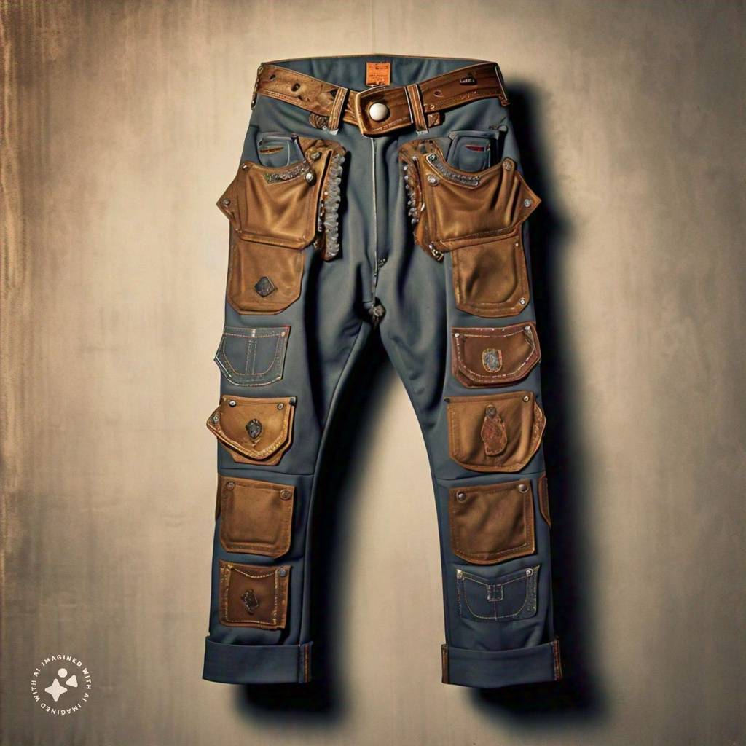



Constraints
Constraints
Budget
To build the necessary database, hiring a skilled team will require a time and financial investment.
Scalability
The database should be scalable to support future growth, enabling easy expansion as the business grows.
Security
To safeguard sensitive customer data, implement access controls and encryption measures.
Performance
The database should perform well during peak times, ensuring efficient data processing and retrieval with minimal latency or downtime.
Armaan Iash Teeruth Roy
“The clothes are so great! I can’t wait for the web store to launch so I can get more!”
Readability
The database structure and design should be user-friendly for easy maintenance and updates by authorized personnel without specialized expertise.

Slide 5







objective:
Product Catalog
Inventory Tracking
Customer Catalog
Including the name, description, price, category, and availability.
Update inventory records promptly in real-time to reflect any sales or restocking activities accurately.
Includes information like names, contact details, and addresses of each customer, in addition to their purchase history.
Order Processing
Employee Record
Stores
Monitor incoming inventory and track its sources.
It contains details such as names, date of employment, and assigned store location.
Includes the store name and address for each location.

Slide 6



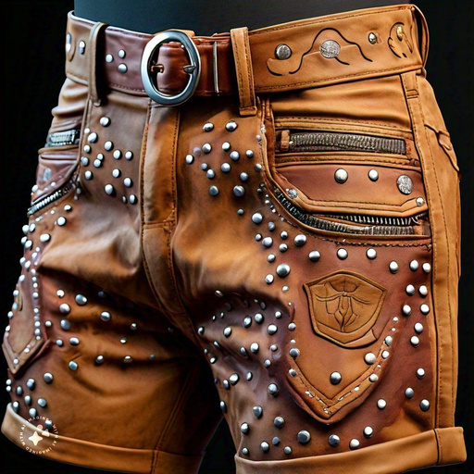


Key
Business
Rules

Slide 7
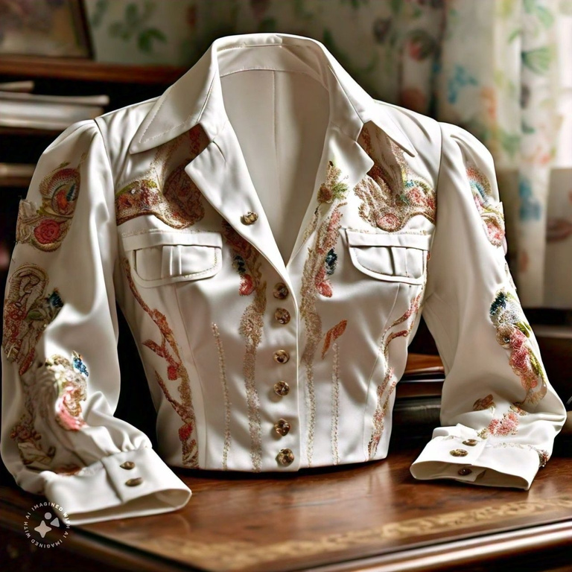


Product Table
Attributes: product number, name, price, category, size, and description.
A product can be associated with many product orders.
With the subtypes:
tOPS
BOTTOMS
SHOES
Additional attributes
sleeve length,
collar type,
type,
if it’s cropped,
design
Additional attributes:
length,
number of pockets,
type,
waistband,
if it’s ripped
Additional attributes:
heel height,
shoe type,
fastenings,
width,
arch support

Slide 8

Invoice Tracking:
INVOICES
INVOICE HISTORY
Each invoice is linked to one customer and one product (identified by product number and size).
Invoice has attributes like: customer code, product details, quantity sold, purchase date, price (from product), total price (derived from quantity and price), invoice number, and store number.
Invoice is created in a specific store.
Each invoice history record is linked to one customer.
It stores total products bought, total price, and a unique ID.
Each invoice is from a specific store.

Slide 9





Employee & CUSTOMER
Each employee's data plays a vital role in facilitating workforce management.
Customer profiles encompass vital details that are integral to enabling personalized service and communication.
Adeline Palmerston
Daniel Gallego
Employee
Customer
Each employee works at one specific store (identified by store number).
Employee has attributes like: employee number, first name, last name, hire date, and fire date (if applicable).
Customer has attributes like: first name, last name, phone number, email, address details, and a unique customer code.

Slide 10

Product Vendor:
Each product order is linked to one product vendor.
Vendor has attributes like: vendor number, name, address details, total billed amount, and total produced amount.

Slide 11


Inventory:
Each inventory record is linked to one specific product (identified by product number and size).
Inventory has attributes like: quantity in stock and notes.

Slide 12

Screenshot

Slide 13
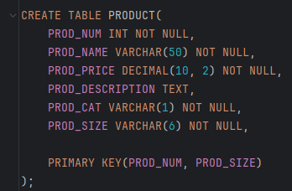
CREATING THE PRODUCT TABLE

Slide 14
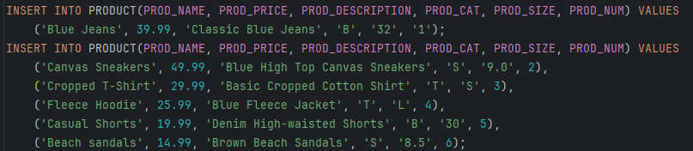
ENTERING SAMPLE DATA IN PRODUCT TABLE

Slide 15
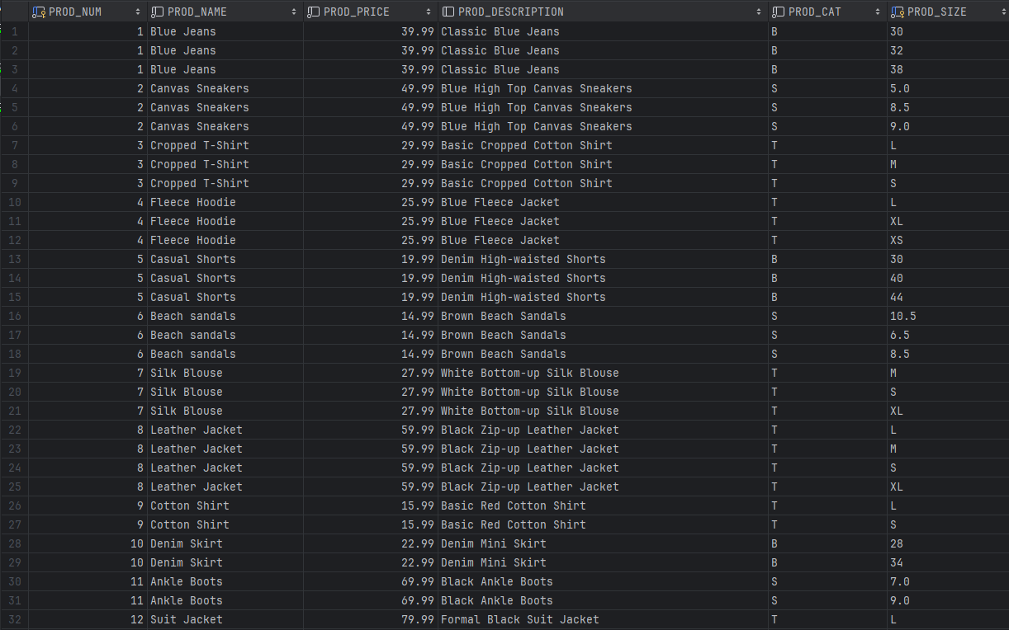
PRODUCT TABLE

Slide 16
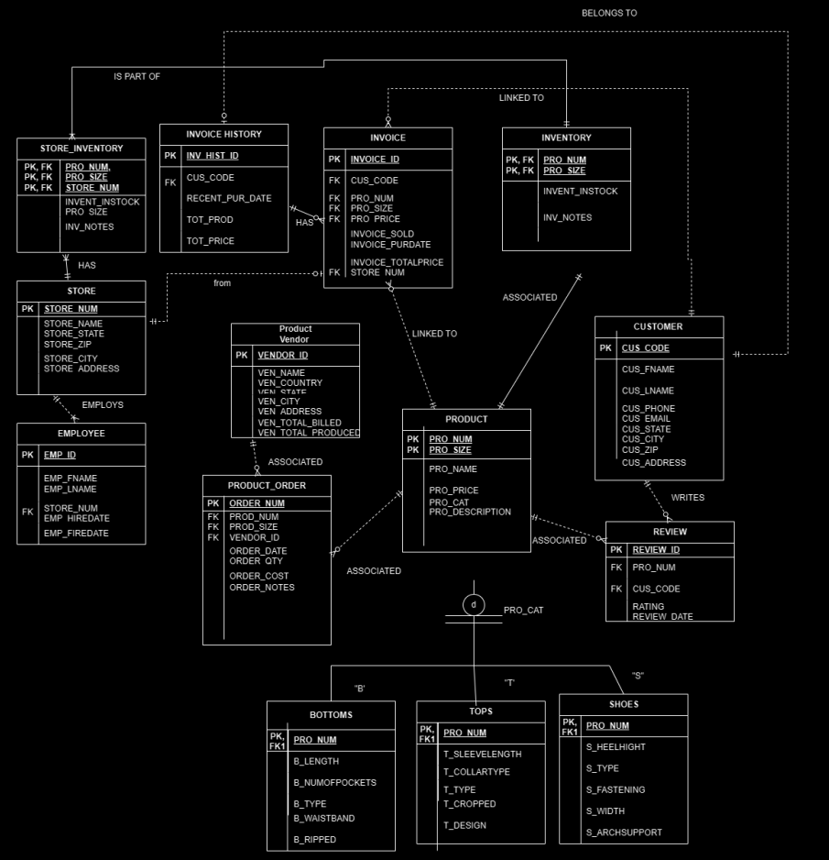
EERD

Slide 17

The biggest challenge
SAMANTHA B.
KNOELLE G.
Creating a complex Entity-Relationship Diagram (EERD) from scratch was challenging due to conceptualizing relationships between entities, determining attributes, and developing meaningful data. Overcoming challenges requires research, consultation, and iterative refinement of the design to meet efficiency and data integrity standards.
My biggest challenge was when I was adding the data of the tables it didn't always work so I had to go back up and fix something. It was usually because a trigger wasn't working right so I had to go through and figure out which one it was and how to fix it.

Slide 18

SUMMARY
The database solution for KGSB Clothing improves inventory management, customer tracking, and data integrity.
IT INCLUDES:
centralized product catalog
real-time inventory tracking
detailed customer profiles
order processing
reporting functions
OUR SOLUTION:
optimizes operations
enhances customer satisfaction
drives growth in the retail market
(by ensuring data accuracy and security)

Slide 19


What we learned...
Database design fundamentals
Gaining hands-on experience
Developing problem-solving skills
Exercising creativity in data modeling
Project management techniques
Knoelle Grassi & Samantha Bentley

